Slide 1

Computer Vision Lecture 12: Local Feature Detectors Part I
School of Software, SJTU

Slide 2
Outline
Image Matching
Local Features
Harris Detector

Slide 3
Image Matching
Image matching is a fundamental aspect of many problems in computer vision.
Object or scene recognition
Solving for 3D structure from multiple images
Stereo correspondence
Image alignment & stitching
Image indexing and search
Motion tracking
Find “interesting” pieces of the image
Focus attention of algorithms
Speed up computation

Slide 4
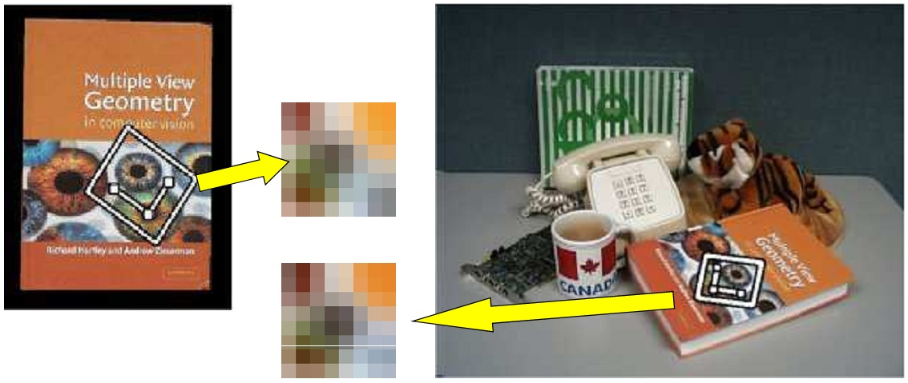
Image Matching Applications
Object recognition: Find correspondences between feature points in training and test images.

Slide 5
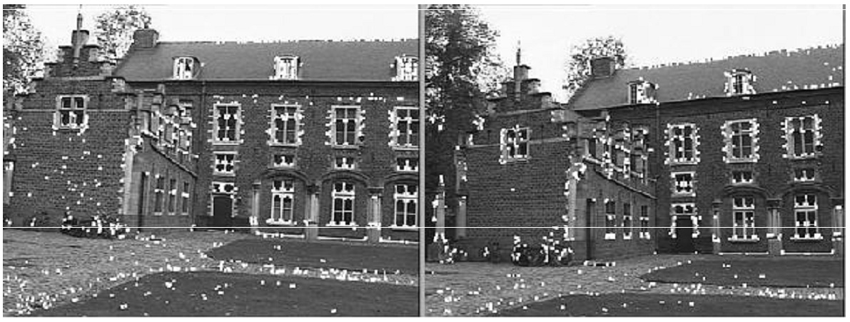
Image Matching Applications
Stereo correspondence

Slide 6
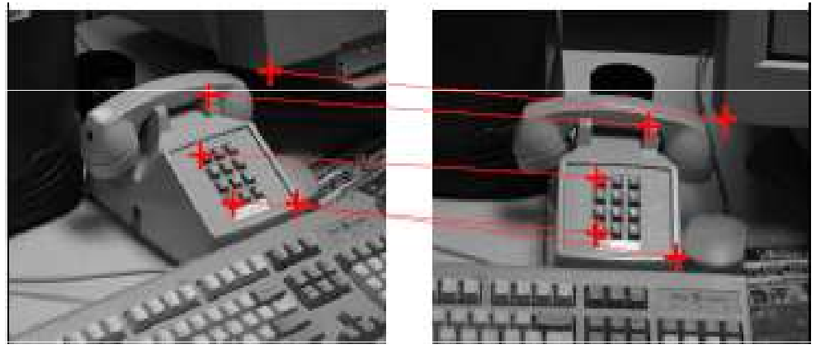
Image Matching Applications
3D reconstruction: find correspondences between feature points in two images of the same scene.

Slide 7
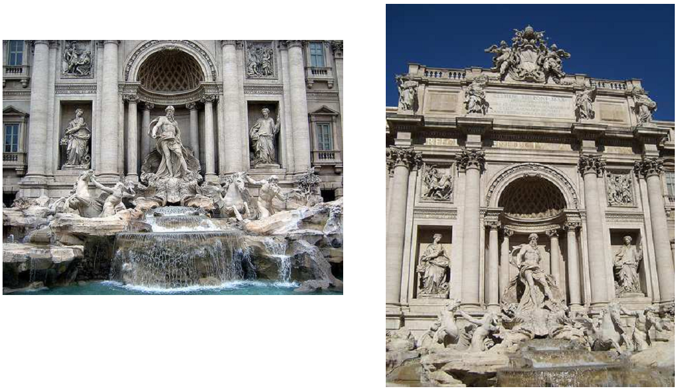
Image Matching Applications
Two images of Rome from Flickr

Slide 8
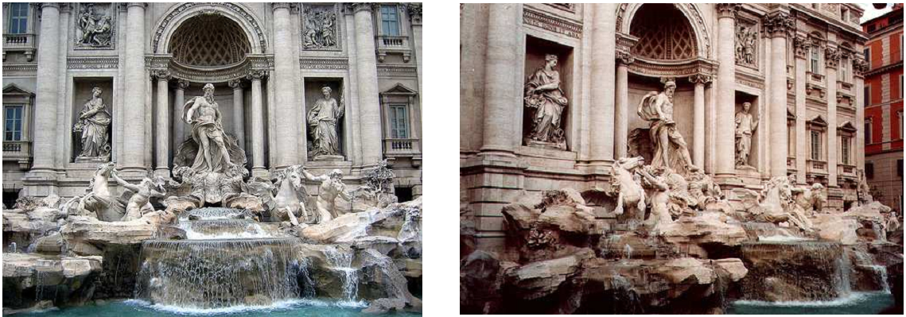
Image Matching Applications
Two images of Rome from Flickr: harder case

Slide 9
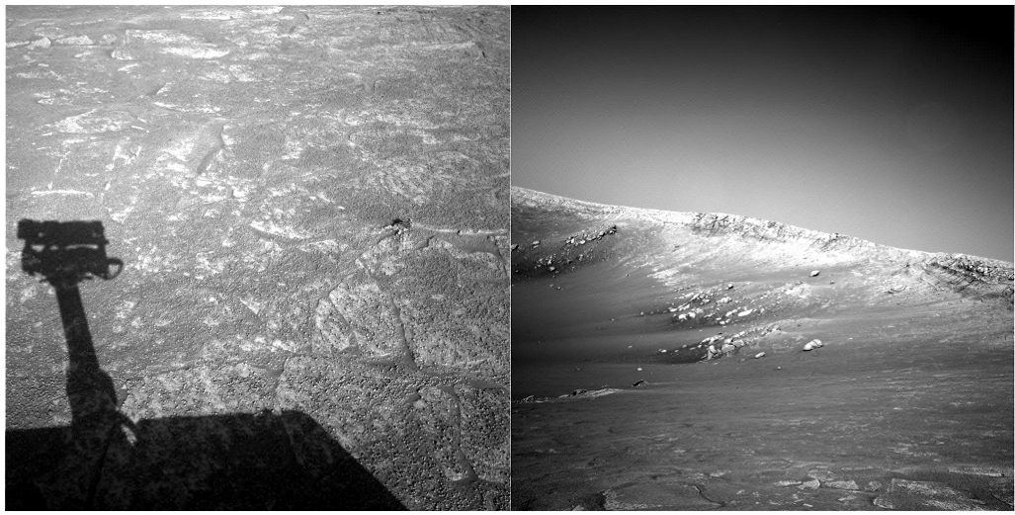
Image Matching Applications
Two images from NASA Mars Rover: even harder case

Slide 10
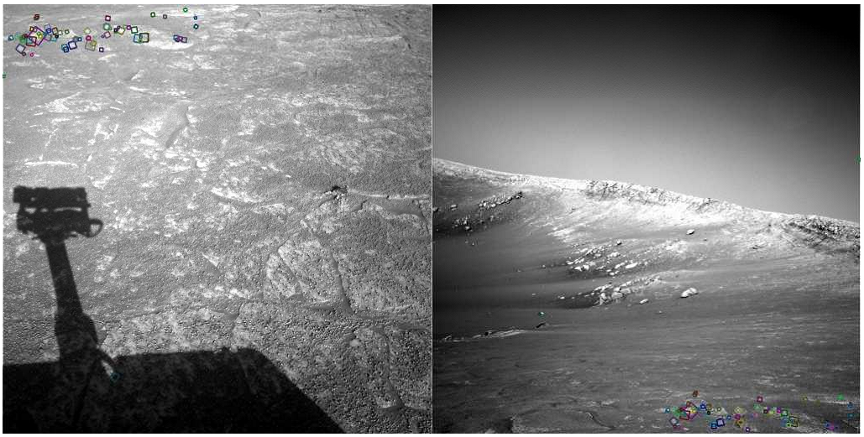
Image Matching Applications
Two images from NASA Mars Rover: matching using local features

Slide 11
Advantages of Local Features
Locality
features are local, so robust to occlusion and clutter
Distinctiveness
can differentiate a large database of objects
Quantity
hundreds or thousands in a single image
Efficiency
real time performance achievable
Generality
exploit different types of features in different situations

Slide 12
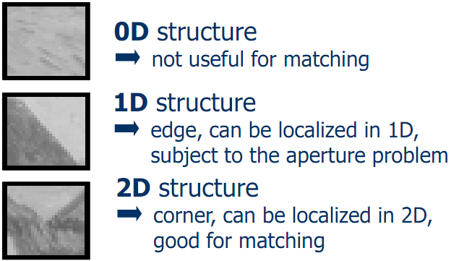
Local Features
What makes a good feature?
We want uniqueness.
Look for image regions that are unusual.
Lead to unambiguous matches in other images.
How to define “unusual”?

Slide 13
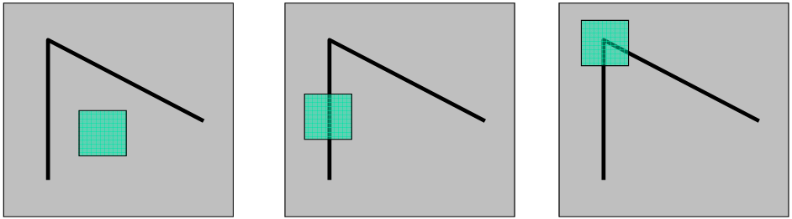
Local Measures of Uniqueness
Suppose we only consider a small window of pixels.
What defines whether a feature is a good or bad candidate?

Slide 14
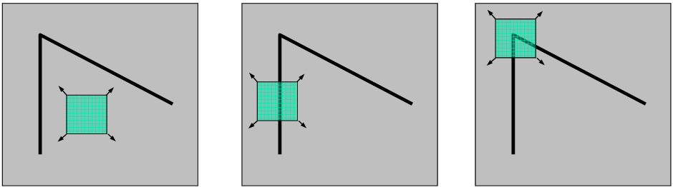
Local Measures of Uniqueness
Local measure of feature uniqueness:
How does the window change when you shift it?
Shifting the window in any direction causes a big change.
“flat” region: | “edge”: | “corner”:
no change in all | no change along | significant change
directions | the edge direction | in all directions

Slide 15
Local Features and Image Matching
There are three important requirements for feature points to have a better correspondence for matching:
Points corresponding to the same scene points should be detected consistently over different views.
They should be invariant to image scaling, rotation and to change in illumination and 3D camera viewpoint.
There should be enough information in the neighborhood of the points so that corresponding points can be automatically matched.
These points are also called interest points.

Slide 16
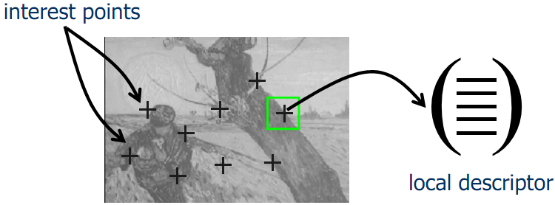
Overview of the Approach
Extraction of interest points (characteristic locations).
Computation of local descriptors.
Determining correspondences.
Using these correspondences for matching/recognition/etc.

Slide 17
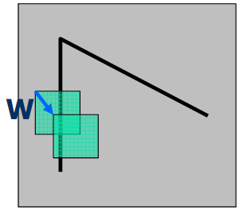
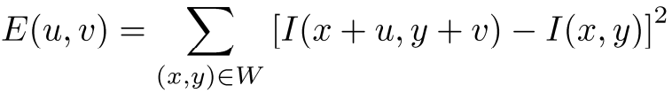
Local Features: Detection
How do the pixels in W change?
Auto-correlation function measures the self similarity of a signal and is related to the sum-of-squared difference.
Compare each pixel before and after the shift by summing up the squared differences (SSD).
This defines an SSD “error” of E(u,v):
Consider shifting the window W by (u,v):

Slide 18
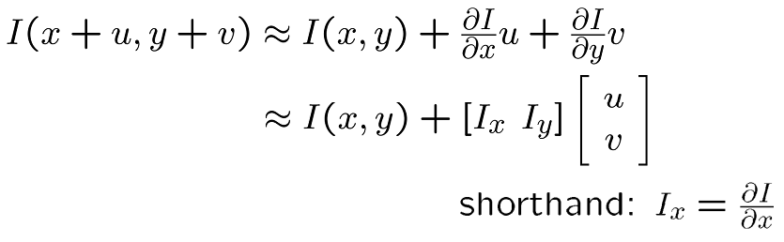
Local Features: Detection
Taylor Series expansion of I:
If the motion (u,v) is assumed to be small, then first order approximation is good.
Plugging this into the formula on the previous slide...

Slide 19
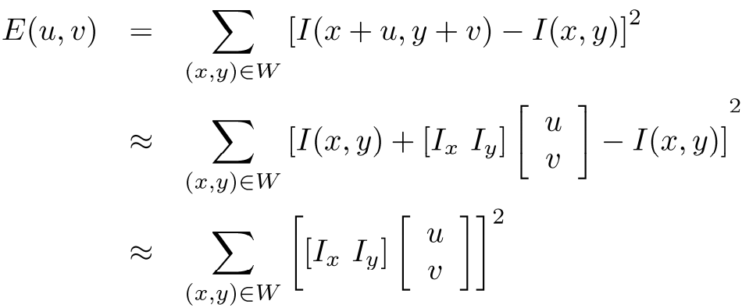
Local Features: Detection
Sum-of-squared differences error E(u,v):

Slide 20
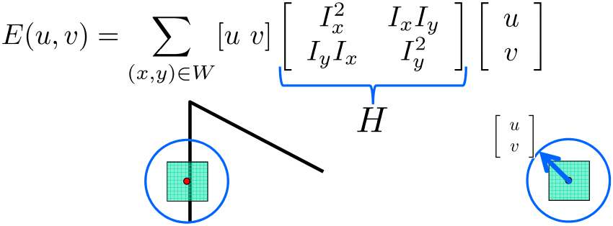
Local Features: Detection
This can be rewritten:
For the example above:
You can move the center of the green window to anywhere on the blue unit circle.
Which directions will result in the largest and smallest E values?
We can find these directions by looking at the eigenvectors of H.

Slide 21
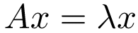
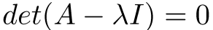
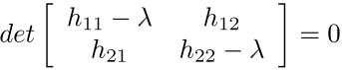
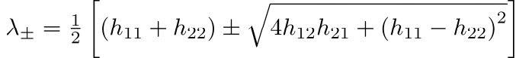
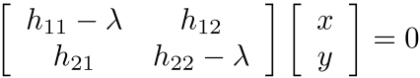
Quick EigenVector/Value Review
The eigenvectors of a matrix A are the vectors x that satisfy:
The scalar λ is the eigenvalue corresponding to x
The eigenvalues are found by solving:
In our case, A = H is a 2x2 matrix, so we have
The solution:
Once you know λ, you find x by solving

Slide 22
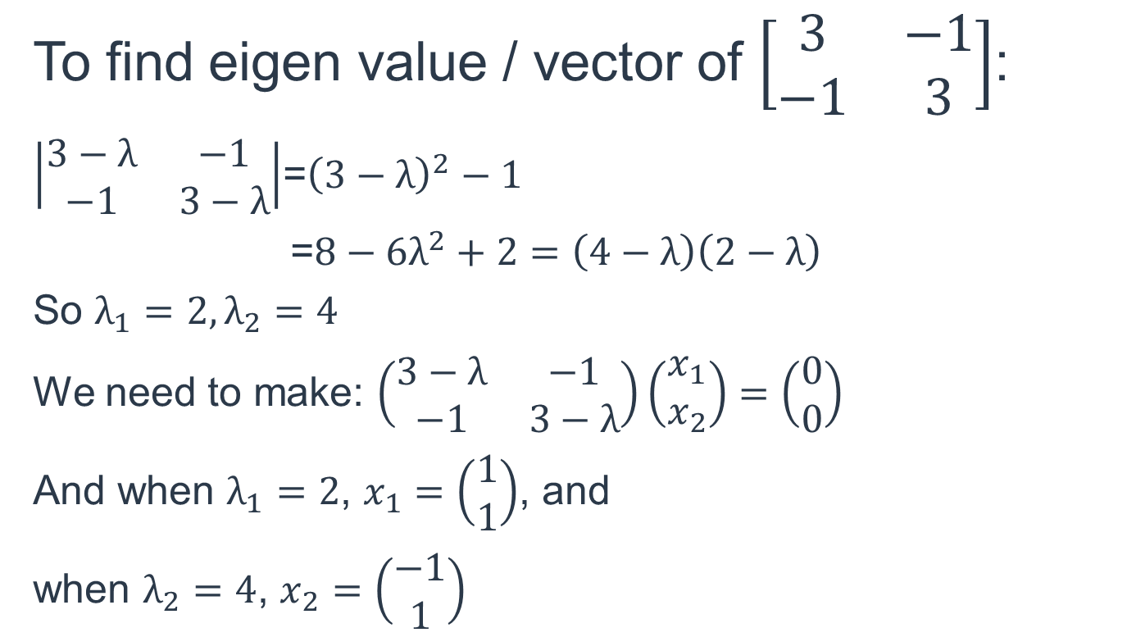
Calculation of Eigen Vector/ Value: Example
To find eigen value / vector of $\left[\begin{matrix}3 & −1 \\ −1 & 3\end{matrix}\right]$:
$\left|\begin{matrix}3−λ & −1 \\ −1 & 3−λ\end{matrix}\right|$=${\left(3−λ\right)}^{2}−1$
=${8−6λ}^{2}+2=\left(4−λ\right)\left(2−λ\right)$
So $λ_{1}=2,λ_{2}=4$
We need to make: $\left(\begin{matrix}3−λ & −1 \\ −1 & 3−λ\end{matrix}\right)\left(\begin{matrix}x_{1} \\ x_{2}\end{matrix}\right)=\left(\begin{matrix}0 \\ 0\end{matrix}\right)$
And when $λ_{1}=2$, $x_{1}=\left(\begin{matrix}1 \\ 1\end{matrix}\right)$, and
when $λ_{2}=4$, $x_{2}=\left(\begin{matrix}−1 \\ 1\end{matrix}\right)$

Slide 23
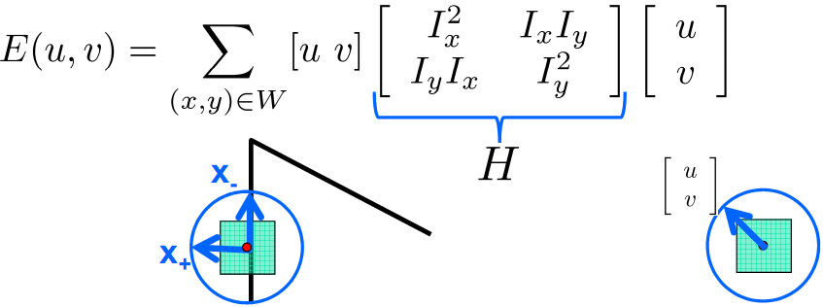
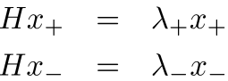
Local Features: Detection
Eigenvalues and eigenvectors of H:
Define shifts with the smallest and largest change (E value).
x₊ = direction of largest increase in E.
λ₊ = amount of increase in direction x₊.
x₋= direction of smallest increase in E.
λ₋= amount of increase in direction x₋

Slide 24
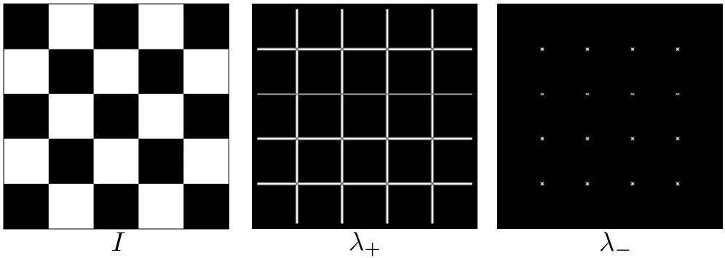
Local Features: Detection
How are λ₊, x₊, λ₋, and x₋relevant for feature detection?:
What’s our feature scoring function?
Want E(u,v) to be large for small shifts in all directions.
The minimum of E(u,v) should be large, over all unit vectors [u v].
This minimum is given by the smaller eigenvalue (λ₋) of H.

Slide 25
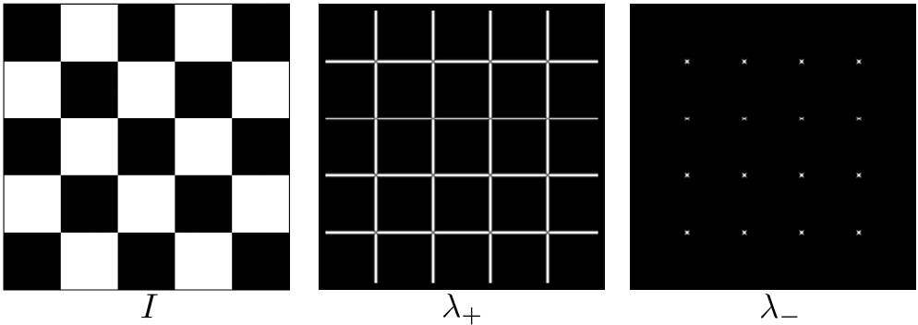
Local Features: Detection
Here’s what you do:
Compute the gradient at each point in the image.
Create the H matrix from the entries in the gradient
Compute the eigenvalues.
Find points with large response (λ₋ > threshold).
Choose those points where λ₋ is a local maximum as features.

Slide 26
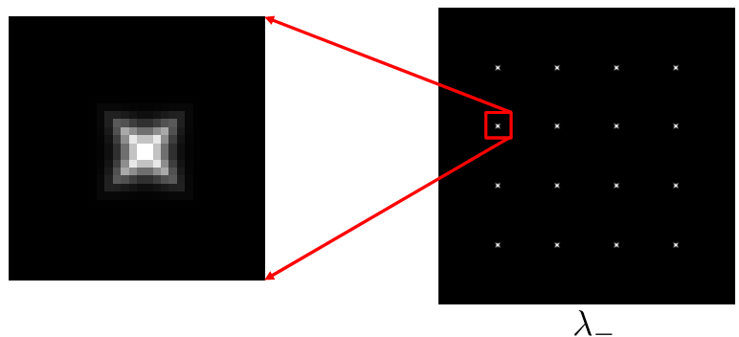
Local Features: Detection
Here’s what you do:
Compute the gradient at each point in the image.
Create the H matrix from the entries in the gradient
Compute the eigenvalues.
Find points with large response (λ₋ > threshold).
Choose those points where λ₋ is a local maximum as features.

Slide 27
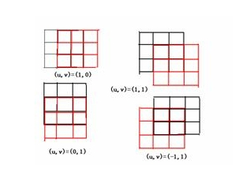
Moravec Detector

Slide 28
Harris Detector
To measure the corner strength:
R = det(H) – k(trace(H))²
where
trace(H) = λ₁ + λ₂
det(H) = λ₁ λ₂
(λ₁ + λ₂ are the eigenvalues of H)
R is positive for corners, negative in edge regions, and small in flat regions.
Very similar to λ₋ but less expensive (no square root).
Also called the “Harris Corner Detector” or “Harris Operator”.
Lots of other detectors, this is one of the most popular.

Slide 29
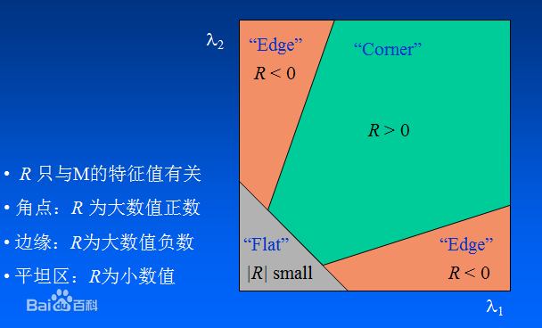
H

Slide 30
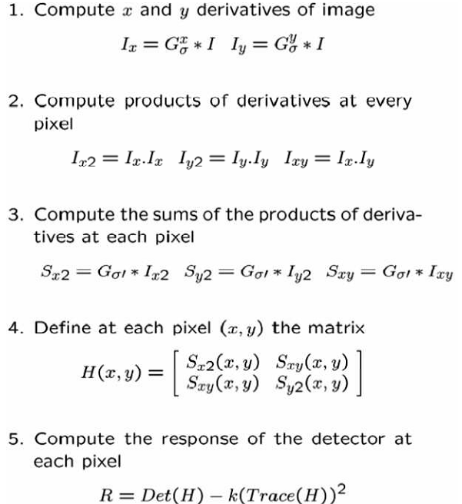
Harris Detector

Slide 31
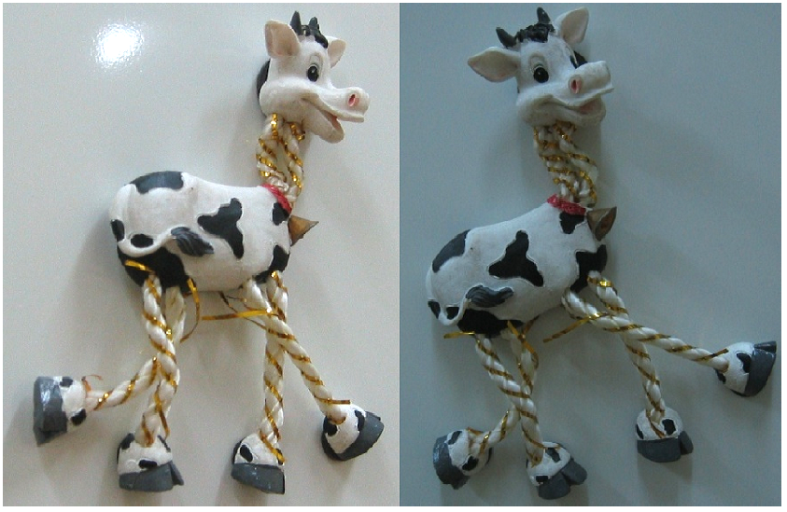
Harris Detector Example

Slide 32
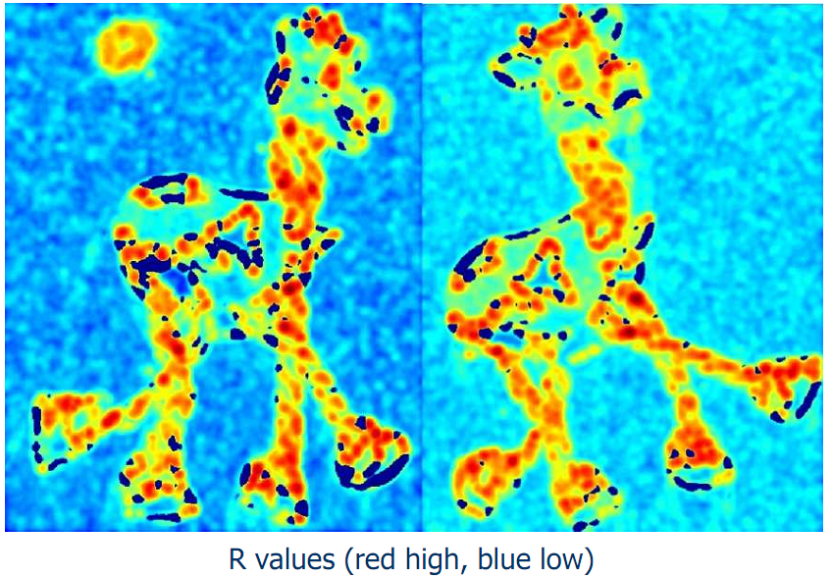
Harris Detector Example

Slide 33
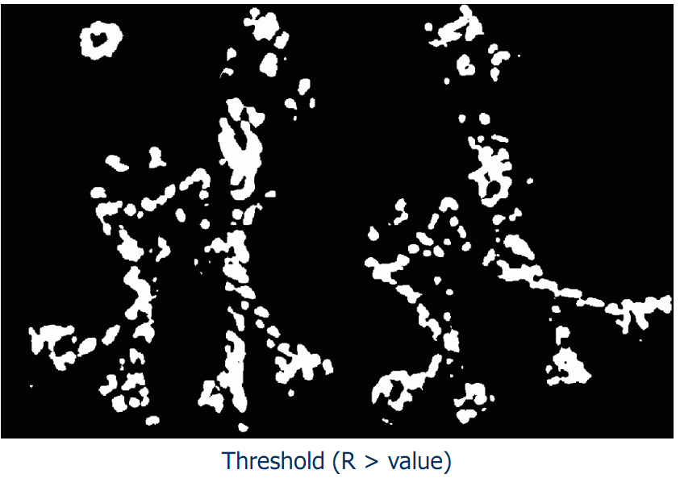
Harris Detector Example

Slide 34
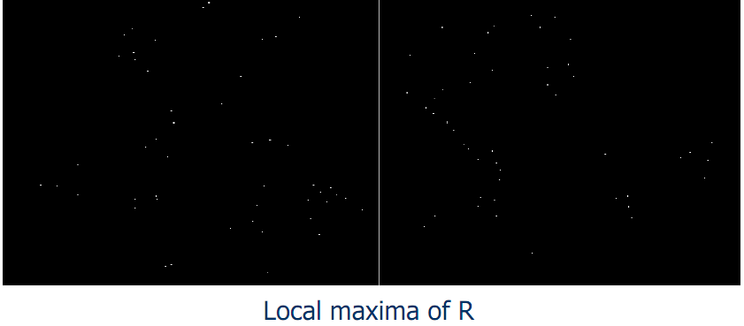
Harris Detector Example

Slide 35
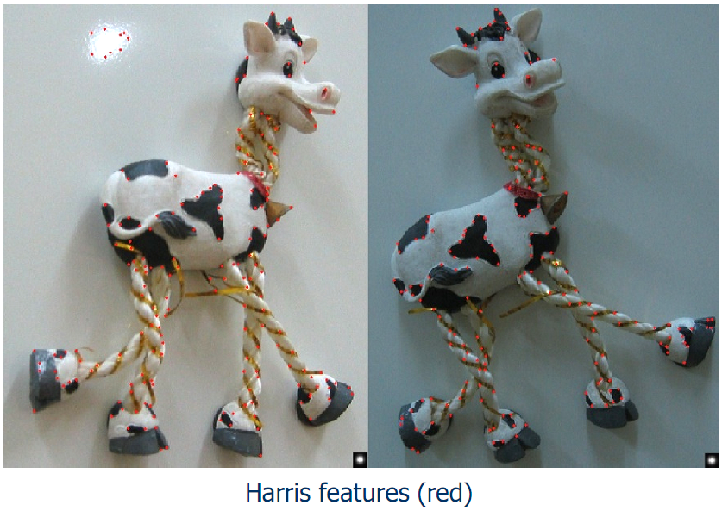
Harris Detector Example

Slide 36
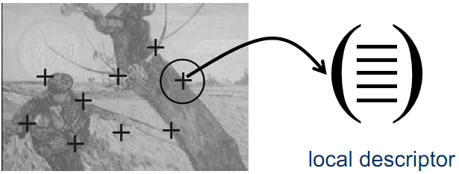
Local Features: Descriptors
Descriptors characterize the local neighborhood of a point.
Grey values within a square window around the point can be used directly.
Grey value derivatives or differential invariants can also be used.

Slide 37
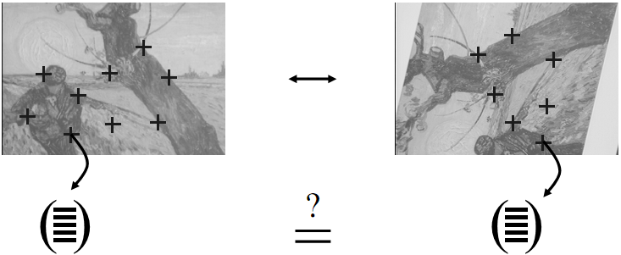
Local Features: Matching
We know how to detect good features.
Next question: how to match them?
Vector comparison using a distance measure can be used.

Slide 38
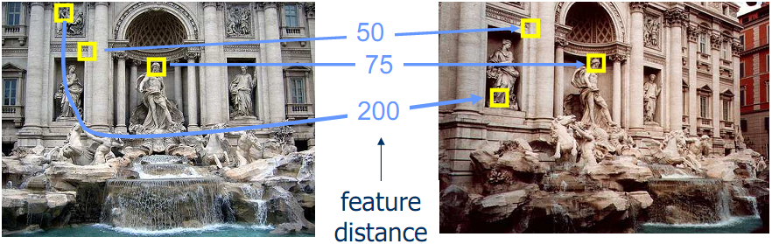
Local Features: Matching
Given a feature in I₁, how to find the best match in I₂?:
Define a distance function that compares two descriptors.
Test all the features in I₂, find the one with minimum distance.

Slide 39
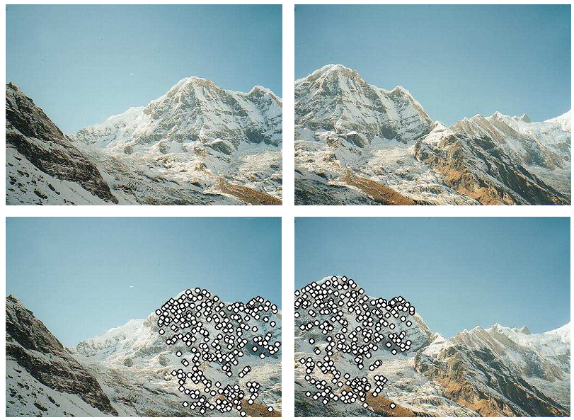
Matching Examples

Slide 40
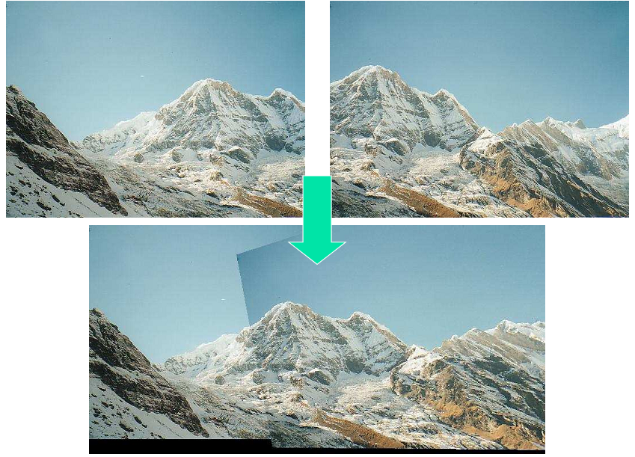
Matching Examples

Slide 41
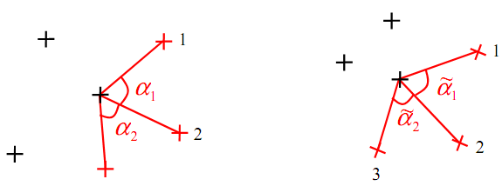
Local Features: Matching
Matches can be improved using local constraints
neighboring points should match
angles, length ratios should be similar

Slide 42
Summary of the Approach
Detection of interest points/regions
Harris detector
Blob detector based on Laplacian
Computation of descriptors for each point
Gray value patch, differential invariants, steerable filter, SIFT descriptor
Similarity of descriptors
Correlation, Mahalanobis distance, Euclidean distance
Semi-local constraints
Geometrical or statistical relations between neighborhood points
Global verification
Robust estimation of geometry between images

Slide 43
Thank you for your attention and attendance.

